Slide 1

Introduction to NLP
Think tokens, not words
Manas Ranjan Kar

Slide 2
What’s NLP ?
Natural Language Processing (NLP) is processing information contained in human language, applying computational techniques to language domain.
It started off as a branch of AI, borrows from linguistics, psycholinguistics, cognitive science and statistics. It makes computers learn our language than we learn theirs. NLP & Computational Linguistics (CL) are used interchangeably

Slide 3
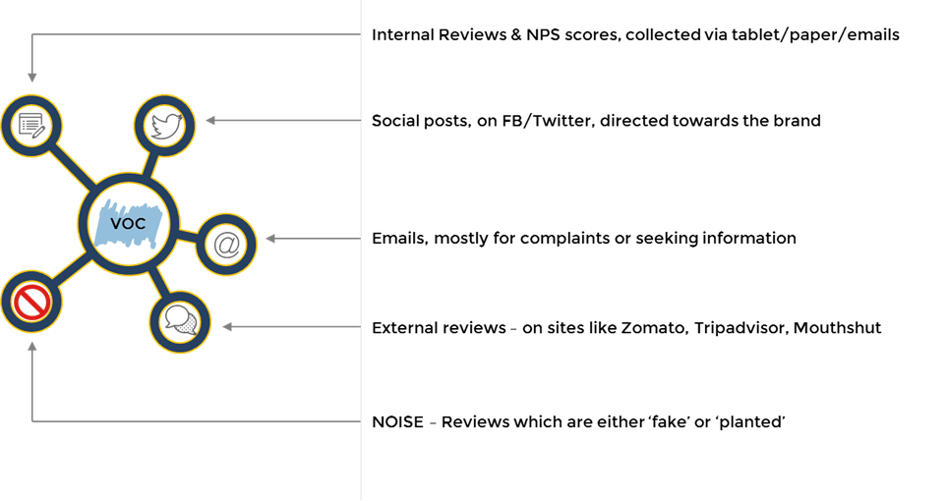
There’s a deluge of information

Slide 4
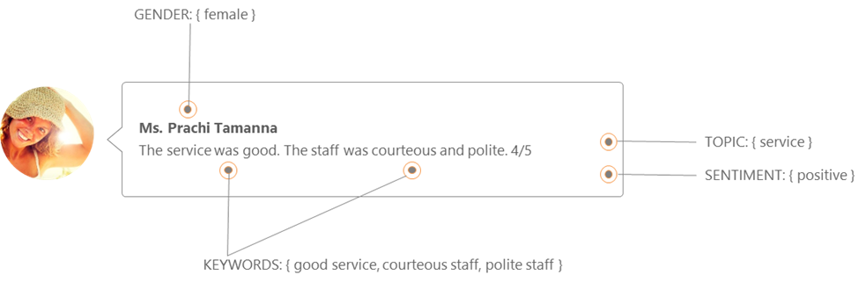
Analyzing information

Slide 5
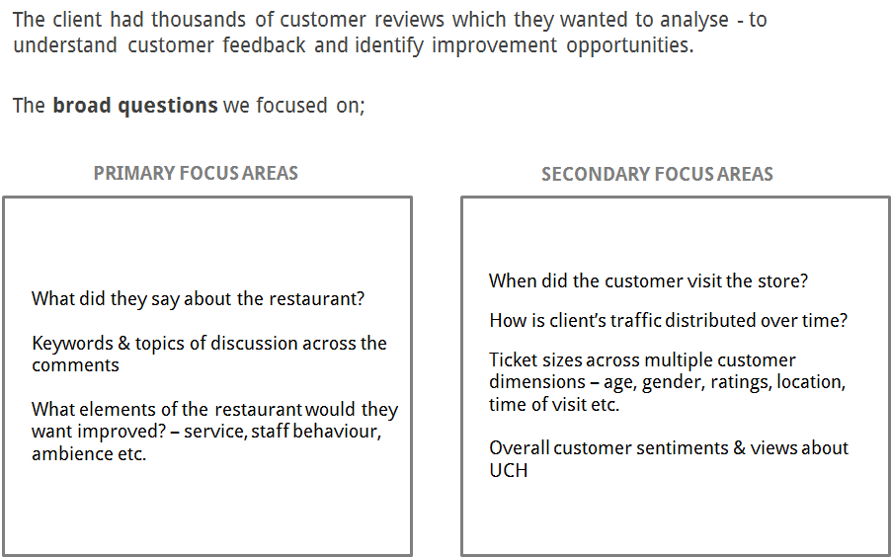

Slide 6
Why is NLP difficult
No single architecture works everywhere
Pipelines need to be modified for different domain
Languages - US vs UK vs Indian English
Preprocessing kills people
Clustering techniques need maximum love and care
Lack of training data
Turnaround times can be higher for clients
CS + Linguistics + Algorithms + Databases -> Beat that !

Slide 7
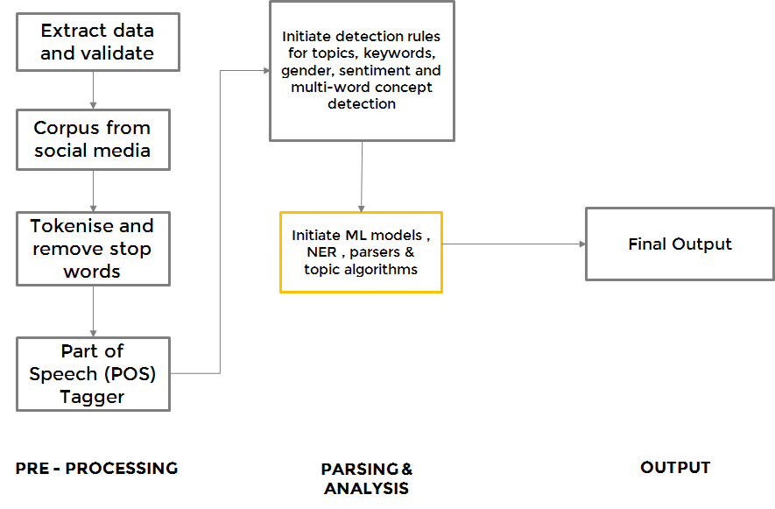
Typical NLP Pipeline

Slide 8
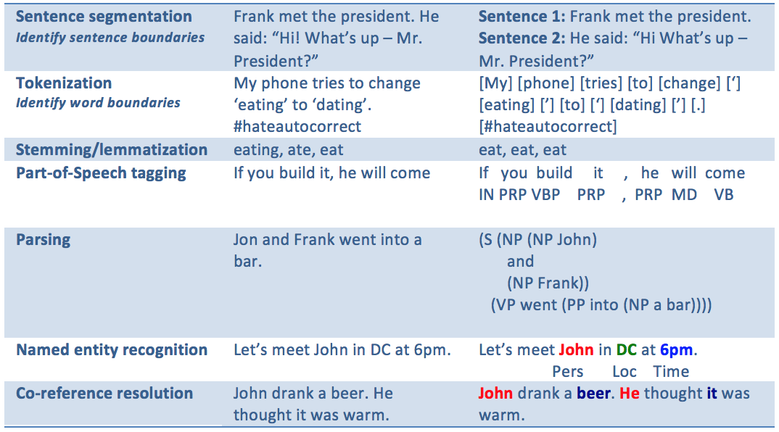
Stepwise into NLP

Slide 9
Possible Transformations for tokens
Google, headquartered in Mountain View, unveiled the new Android phone. Sundar Pichai said in his keynote that users love their new Android phones’ operating systems.
['google,', 'headquartered', 'in', 'mountain', 'view,', 'unveiled', 'the', 'new', 'android', 'phone.', 'sundar', 'pichai', 'said', 'in', 'his', 'keynote', 'that', 'users', 'love', 'their', 'new', 'android', 'phones’', 'operating', 'systems.']
⟨EN_google⟩, headquartered in ⟨EN_mountain_view⟩, unveiled the new ⟨EN_android⟩ phone.
⟨EN_sundar_pichai⟩ said in his keynote that users love their new ⟨EN_android⟩ phones’ (PHR_operating_systems)

Slide 10
Makings of a good NLP Scientist
Maximum enrichment - add more information
Minimum information loss - minimal stopwords, minimal stemming
Assume word dependencies - do BOW, don’t think BOW
Features engineering is key !
Make a pipeline - clean, tokenize, NER, phrase extraction, ML - reuse architectures*
Create your datasets - Crowdflower, Amazon MT or scrape !
Learning to create grammars for parsing
Understanding Linguistics and how it affects your pipeline
Be close to the business problem - don’t make it an academic hunt

Slide 11
Data Resources
RESOURCE | DESCRIPTION | LINK
WORDNET | Large lexical database of English. Nouns, verbs, adjectives and adverbs are grouped into sets of cognitive synonyms (synsets), each expressing a distinct concept. | https://wordnet.princeton.edu/
SENTIWORDNET | SentiWordNet assigns to each synset of WordNet three sentiment scores: positivity, negativity, objectivity. | http://sentiwordnet.isti.cnr.it/
LDC | LDC's Catalog contains hundreds of datasets for research, both free and paid. | https://www.ldc.upenn.edu/
WIKIPEDIA | Wikipedia offers free copies of all available content to interested users. These databases can be used for mirroring, personal use, informal backups, offline use or database queries | https://dumps.wikimedia.org/enwiki/
MOVIE REVIEWS | Dataset of 25,000 highly polar movie reviews for training, and 25,000 for testing. | http://ai.stanford.edu/~amaas/data/sentiment/

Slide 12
Questions?
Manas Ranjan Kar | manasrkar91@gmail.com GitHub: manasRK @manasrnkar

